Slide 1

RETAIL STORE SALES REPORT
PRESENTED BY
VAISHNAVI BHUJBAL.

Slide 2
AGENDA OF REPORT
INTRODUCTION
OBJECTIVE
ANALYSIS OF VISUAL
KEY BUSINESS QUESTIONS ANSWERED
SIGNIFICANCE OF VISUALS
INSIGHTS
CONCLUSION

Slide 3
Introduction
This project focuses on analyzing retail sales data through a comprehensive dashboard to uncover actionable insights.
The dashboard highlights key metrics such as sales performance, customer demographics, product trends, store locations, and payment preferences.
It simplifies complex data to identify patterns, improve decision-making, and optimize marketing, inventory, and operations.
By leveraging these insights, businesses can drive growth, enhance customer satisfaction, and strengthen their competitive position.

Slide 4
Objective
The objective of this project is to analyze retail sales data to uncover actionable insights that support informed business decisions. Key goals include:
Identifying high-performing customer demographics.
Evaluating product, category, and store performance.
Understanding sales trends over time for better planning.
Optimizing online vs. in-store sales strategies.
Analyzing payment preferences to enhance customer experience.
This ensures data-driven strategies to boost revenue, streamline operations, and improve customer satisfaction.

Slide 5
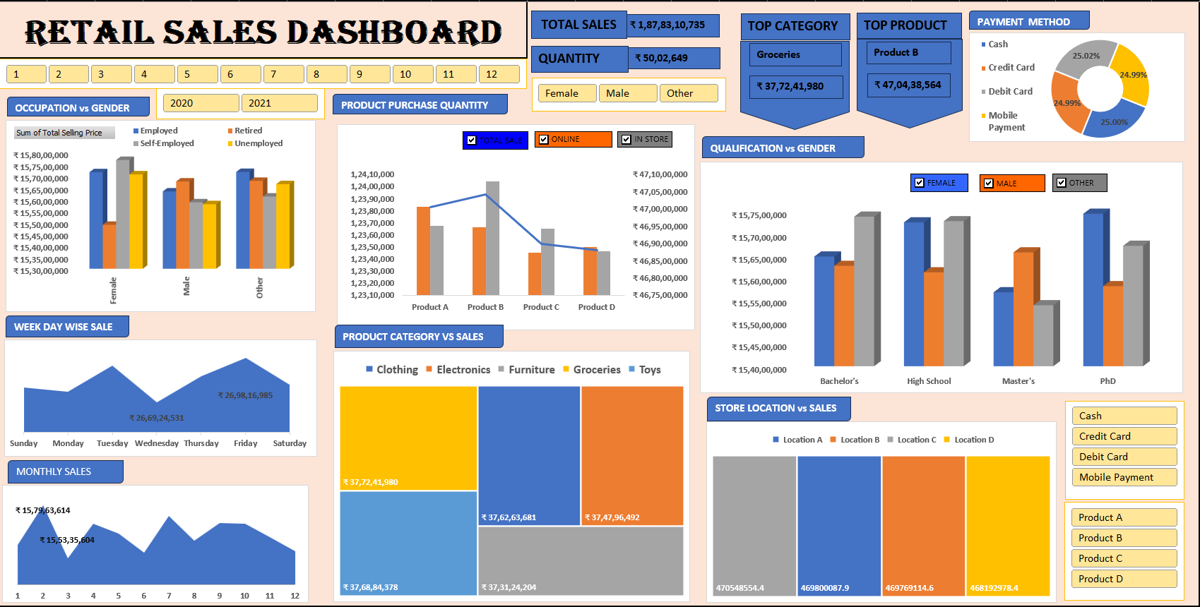
COMPLETE DASHBOARD
RETAIL SALES REPORT

Slide 6
Analysis of Visual Key Business Questions Answered Significance of Visuals
NEXT SLIDES WITH VISUALS SHOW THE ABOVE POINTS :

Slide 7
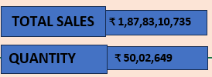
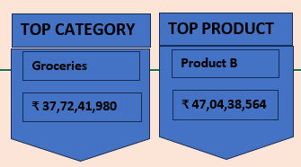
1. KEY MATRIX PANELS
Purpose:
Display KPIs such as total sales, quantity sold,
top category, and top product.
Insights Provided:
Offers a quick overview of overall performance and
top performers.
Business Questions Solved:
What are the current top products and categories?
What is the total revenue and quantity sold?
Why this format?
KPI panels are concise and highlight the most
critical metrics at a glance.

Slide 8
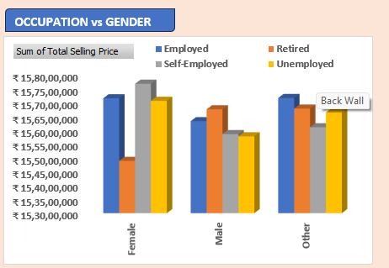
2. OCCUPATION VS. GENDER
Purpose: Compares sales performance across different
occupations (employed, self-employed, retired,
unemployed) and genders (female, male, other).
Insights Provided:
Helps identify which gender-occupation groups contribute
most to sales.
Useful for targeted marketing or promotional campaigns.
Business Questions Solved:
Which gender and occupation groups generate the
highest revenue?
Should campaigns focus on a specific demographic?
Why this chart type (Bar Chart)?
Bar charts effectively compare categorical data across
multiple categories (gender and occupation)

Slide 9
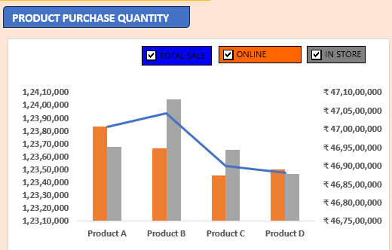
3. PRODUCT PURCHASE QUANTITY
Purpose:
Analyzes total sales (online vs in-store) for different
products.
Insights Provided:
Identifies the most sold products and their
performance in online and in-store sales.
Guides inventory and marketing strategies for
underperforming channels.
Business Questions Solved:
Which products are selling better online or in-store?
How can resources be allocated to improve channel
-specific sales?
Why this chart type (Bar Chart with Line)?
Bar charts show the breakdown of online/
sales, while the line helps track overall trends.

Slide 10
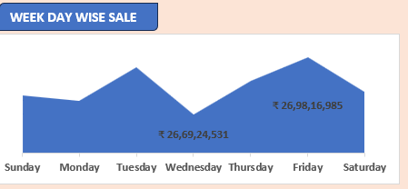
4.WEEK DAY WISE SALE
Purpose:
Displays sales trends across the week.
Insights Provided:
Identifies high and low sales days, enabling
optimized operational planning and promotions.
Business Questions Solved:
Which days see the highest and lowest sales?
When should promotional campaigns be launched?
Why this chart type (Line Chart)?
Line charts highlight trends over a sequence (days
of the week).

Slide 11
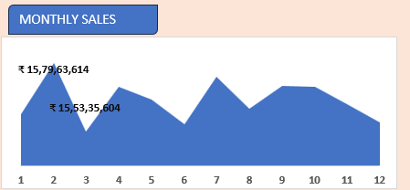
5.MONTHLY SALES
Purpose:
Tracks monthly sales performance throughout the year.
Insights Provided:
Seasonal trends in sales can be identified.
Helps in financial forecasting and inventory planning.
Business Questions Solved:
Which months generate peak sales?
How should inventory be managed for seasonal demand?
Why this chart type (Line Chart)?
Line charts efficiently represent trends over time (months).

Slide 12
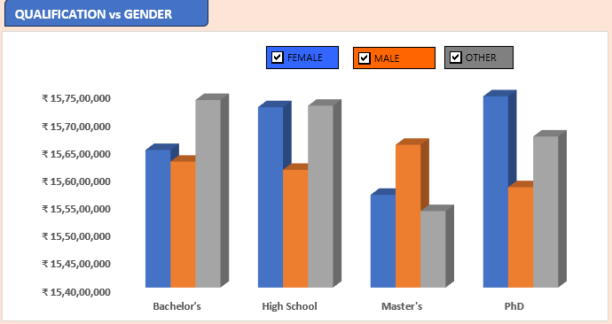
6. QUALIFICATION VS. GENDER
Purpose:
Compares sales by customer qualification level and
gender.
Insights Provided:
Provides demographic insights on education level and
sales contributions.
Business Questions Solved:
How do education levels influence purchasing behavior
across genders?
Should campaigns target specific education levels?
Why this chart type (Bar Chart)?
Bar charts clearly compare categorical data across multiple
dimensions (qualification and gender).

Slide 13
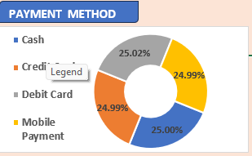
7. PAYMENT METHOD
Purpose:
Illustrates the proportion of sales by payment methods.
Insights Provided:
Shows customer preferences for payment modes.
Helps in deciding whether to expand payment options.
Business Questions Solved:
Which payment methods are most popular?
Should any payment methods be incentivized or promoted?
Why this chart type (Pie Chart)?
Pie charts are intuitive for visualizing proportions of a whole.

Slide 14
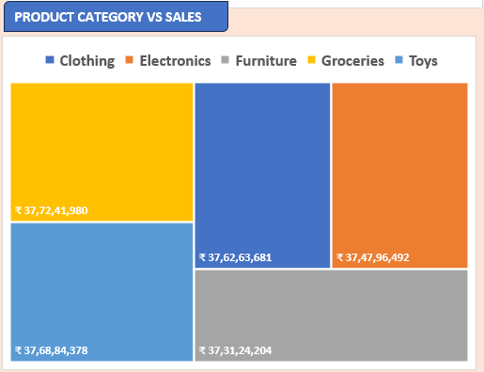
8. PRODUCT CATEGORY VS. SALES
Purpose:
Shows the revenue contribution of different product
categories.
Insights Provided:
Helps in identifying the most and least profitable
categories.
Business Questions Solved:
Which categories should be promoted or discontinued?
How can resources be distributed across categories?
Why this chart type (Tree map)?
Tree maps visualize hierarchical data proportionally,
making it easier to understand sales distribution.

Slide 15
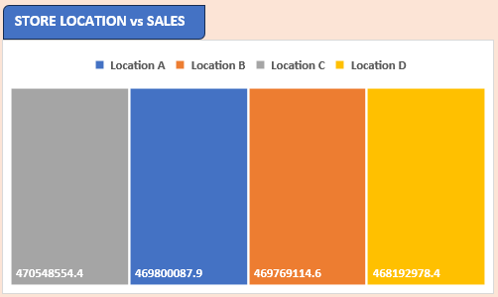
9. STORE LOCATION VS. SALES
Purpose:
Highlights sales performance across store locations.
Insights Provided:
Identifies the best and worst-performing locations.
Business Questions Solved:
Which locations generate the highest sales?
Should resources be shifted to underperforming
locations?
Why this chart type (Tree Maps)?
Tree maps visualize hierarchical data proportionally,
making it easier to understand sales distribution.

Slide 16
ACTIONABLE INSIGHTS
Target Demographics: Focus marketing campaigns on employed women
and customers with Master’s or PhD qualifications.
Boost Underperforming Areas: Address the low performance of the
Toys category and Location B to unlock additional revenue potential.
Seasonal and Daily Promotions: Schedule campaigns during June, November, Wednesdays, and Fridays to maximize returns.
Channel Optimization: Leverage online channels for products performing well digitally, while maintaining in-store efficiency.
Payment Incentives: Encourage mobile payments and credit card usage with offers like discounts or cashback.

Slide 17
CONCLUSION
The Retail Sales Dashboard provides critical insights into the business’s performance across demographics, products, time periods, store locations, and payment methods.
It highlights strengths such as strong sales from employed women, Master’s degree holders, and top-performing products like Product B and Groceries.
It also identifies improvement areas, such as underperforming categories like Toys, lower sales in Location B, and opportunities to incentivize preferred payment methods.

Slide 18
Thank you

